Slide 1
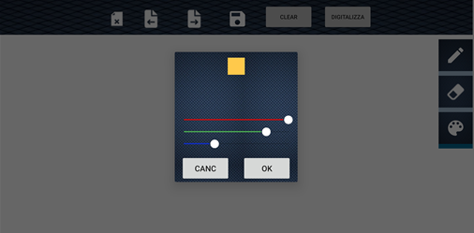
DialogColor -1
Questo è un Fragment che estende la classe DialogFragment
DialogColor permette all’utente di scegliere il colore della penna per disegnare sulla lavagna, tramite seekbar, combinando la tabella rgb

Slide 2
DialogColor -2
class ColorDialog : DialogFragment() { private var colorImageView: ImageView? = null private var redValue : Int = 0 private var greenValue : Int = 0 private var blueValue : Int = 0 private var colors : Int = Color.BLACK private var colorListener: (colors : Int) -> Unit = { } private var cancelListener: () -> Boolean ={ true } private lateinit var binding: ChooseColorDialogBinding companion object{ fun getInstance(): ColorDialog{ var instance : ColorDialog? = null if(instance == null){ instance = ColorDialog() } return instance } }

Slide 3
DialogColor -3
override fun onCreateView( inflater: LayoutInflater, container: ViewGroup?, savedInstanceState: Bundle?): View { binding = ChooseColorDialogBinding.inflate(inflater) colorImageView = binding.ColorPicker colorImageView!!.setBackgroundColor(Color.BLACK) isCancelable = false setSeek() return binding.root } override fun onViewCreated(view: View, savedInstanceState: Bundle?) { binding.ColorPicker binding.seekBarB binding.seekBarG binding.seekBarR setSeek() binding.btnOk.setOnClickListener{ colorListener(colors) dismiss() } binding.btnCanc.setOnClickListener{ if(cancelListener()) dismiss() } } fun setOnColorSelected(listener: (color: Int)-> Unit){ this.colorListener=listener } fun setOnCancelSelected(listener: () -> Boolean){ cancelListener = listener }

Slide 4
Gestione della seekbar -1
Per gestire il cambiamento di valore della seekbar bisogna eseguire override dei metodi:
onProgressChanged(
seekBar: SeekBar,
progress: Int,
fromUser: Boolean )//segnala il cambiamento del livelli
onStartTrackingTouch(
seekBar: SeekBar?) //segnala inizio del tocco da parte dell’utente
onStopTrackingTouch(
seekBar: SeekBar?) //segnala fine del tocco da parte dell’utente

Slide 5
Gestione della seekbar -2
private fun setSeek(){ val seekBarR = binding.seekBarR val seekBarG = binding.seekBarG val seekBarB = binding.seekBarB seekBarR.setOnSeekBarChangeListener(mChangeListener) seekBarG.setOnSeekBarChangeListener(mChangeListener) seekBarB.setOnSeekBarChangeListener(mChangeListener) } private val mChangeListener: SeekBar.OnSeekBarChangeListener = object : SeekBar.OnSeekBarChangeListener { override fun onProgressChanged( seekBar: SeekBar, progress: Int, fromUser: Boolean ) { val viewId = seekBar when (viewId) { binding.seekBarR -> redValue = progress binding.seekBarG -> greenValue = progress binding.seekBarB -> blueValue = progress } colors = Color.rgb(redValue, greenValue, blueValue) colorImageView!!.setBackgroundColor(colors) } override fun onStartTrackingTouch(seekBar: SeekBar?) { } override fun onStopTrackingTouch(seekBar: SeekBar?) { } }

Slide 6
Creazione del dialog
binding.btnPickColor.setOnClickListener{ val colorPick = ColorDialog.getInstance() var colore : Int colorPick.setOnColorSelected {
colore = it binding.whiteboard.drawingMode = DrawingMode.DRAW binding.selected2.setBackgroundColor(ContextCompat.getColor(this,R.color.unselected)) binding.selected.setBackgroundColor(ContextCompat.getColor(this,R.color.selected_blue)) binding.selected3.setBackgroundColor(ContextCompat.getColor(this,R.color.unselected)) setColor(colore) }
colorPick.setOnCancelSelected { binding.whiteboard.drawingMode = DrawingMode.DRAW binding.selected2.setBackgroundColor(ContextCompat.getColor(this,R.color.unselected)) binding.selected.setBackgroundColor(ContextCompat.getColor(this,R.color.selected_blue)) binding.selected3.setBackgroundColor(ContextCompat.getColor(this,R.color.unselected)) true } colorPick.show(supportFragmentManager,"ColorDialog")

Slide 7
PenDialog
penTouch = 0
…
binding.btnPen.setOnClickListener{ binding.whiteboard.drawingMode= DrawingMode.DRAW binding.whiteboard.isEnabled = true penTouch++ … val penPick = PenDialog.getInstance() var value : Int penPick.setOnStrokeSelected { penTouch = 1 value = it setStroke(value) } if(penTouch==2) penPick.show(supportFragmentManager,"PenDialog")
}

Slide 8
TextResultActivity -1
Una volta creata una nota abbiamo la possibilità tramite un menu di scegliere se modificarla, salvarla, copiarla, o cancellarla
Inoltre ci sono 3 diverse features:
Traduzione
Salvare in formato pdf
Metterla tra i preferiti

Slide 9
TextResultActivity -2
class TextResultActivity : AppCompatActivity() {
… override fun onCreate(savedInstanceState: Bundle?) { super.onCreate(savedInstanceState) binding = ActivityTextResultBinding.inflate(layoutInflater) setContentView(binding.root) note = intent.getParcelableExtra("result") ?: Note("","","","",System.currentTimeMillis(),false) textResult = note.text language = note.language originalText=textResult whiteboard = intent.getParcelableExtra("whiteboard") ?: DigitalizedWhiteboards() val ordinal = intent.getIntExtra("type",TextResultType.NOT_SAVED.ordinal) type = when(ordinal){ TextResultType.SAVED.ordinal -> TextResultType.SAVED TextResultType.EDITABLE.ordinal -> TextResultType.EDITABLE else -> TextResultType.NOT_SAVED } initializeDB() setUI() }

Slide 10
Creazione del menu -1
override fun onCreateOptionsMenu(menu: Menu?): Boolean { menuInflater.inflate(R.menu.text_result_menu,menu) this.menu=menu!! setType(menu) return super.onCreateOptionsMenu(menu) } private fun setType(menu: Menu?){ var itSave: MenuItem? = null var itDelete: MenuItem? = null var itUndo: MenuItem? = null for (item in menu!!.children){ when(item.itemId){ R.id.it_delete -> itDelete=item R.id.it_save -> itSave=item R.id.it_undo -> itUndo=item } } when(type){ TextResultType.SAVED -> { itDelete!!.isVisible=true itSave!!.isVisible=false itUndo!!.isVisible=false } TextResultType.NOT_SAVED -> { itDelete!!.isVisible=false itSave!!.isVisible=true itUndo!!.isVisible=false } TextResultType.EDITABLE->{ itDelete!!.isVisible=false itSave!!.isVisible=true itUndo!!.isVisible=true }

Slide 11
Creazione del menu -2
override fun onOptionsItemSelected(item: MenuItem): Boolean { when(item.itemId){ R.id.it_save -> { } R.id.it_editable->{ } R.id.it_undo -> { } R.id.it_delete -> { } R.id.it_copy -> { } return super.onOptionsItemSelected(item) }

Slide 12
Salvare la nota
CoroutineScope(Dispatchers.IO).launch { val directoryList = dao.loadDirectories() CoroutineScope(Dispatchers.Main).launch { val dialog = MakeDirectoryDialog.getInstance() dialog.setDirectoryList(directoryList) if (type == TextResultType.NOT_SAVED) { dialog.setOnDirectorySelected { directory: String, title: String -> note.text = textResult note.language = language note.directory = directory note.title = title CoroutineScope(Dispatchers.IO).launch { dao.insertNote(note)
…
}
}
}
}

Slide 13
Editare nota
Prima di poter modificare la nota bisogna salvarla
if(type==TextResultType.NOT_SAVED){ Toast.makeText(this,getString(R.string.not_saved_edit),Toast.LENGTH_LONG).show() } ....
if (editable) { type = TextResultType.EDITABLE binding.editTextTextMultiLine.isEnabled = true setType(menu) }

Slide 14
Ritornare alla nota originale
R.id.it_undo -> { binding.editTextTextMultiLine.text.clear() binding.editTextTextMultiLine.text.append(originalText) textResult=originalText }

Slide 15
Eliminare la nota
CoroutineScope(Dispatchers.IO).launch { dao.deleteNote(note) CoroutineScope(Dispatchers.Main).launch { dialogInterface.cancel() finish() } }

Slide 16
Copiare la nota
R.id.it_copy -> { val clipboard = getSystemService(Context.CLIPBOARD_SERVICE) as ClipboardManager val clip = ClipData.newPlainText("note",textResult) clipboard.setPrimaryClip(clip)

Slide 17
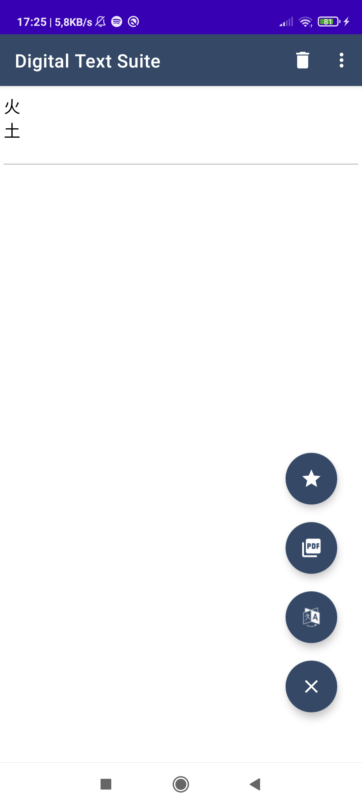
Mettere la nota tra i preferiti
Una feature che troviamo è quella di salvare le nostre note preferite per trovarle più facilmente nella sezione dedicata
Nel bottone indicato apparirà la stella piena (salvata tra i preferiti), altrimenti solo contorno della stella

Slide 18
Salvare la nota tra i preferiti
binding.fabFavourite.setOnClickListener{ CoroutineScope(Dispatchers.IO).launch{ note.preferito = !note.preferito dao.updateNote(note) CoroutineScope(Dispatchers.Main).launch{ binding.fabFavourite.setImageDrawable(if(note.preferito) ContextCompat.getDrawable(this@TextResultActivity,R.drawable.ic_baseline_star_24) else ContextCompat.getDrawable(this@TextResultActivity,R.drawable.favourite_icon_24)) } } }

